Slide 1
Chapter 4
Digital Image Fundamentals

Slide 2
Need for Image Processing
Improvement of Pictorial Information for Human Perception
Noise Filtering
Contrast Enhancement
Deblurring etc.
Image Processing for Autonomous Machine Application
Industrial Machine Vision for Product assembly and inspection
Automated Target detection and tracking
Finger Print Recognition
Machine Processing of satellite and aerial imagery
Video Sequence Processing ( Movement Detection)
Efficient storage/ transmission
Image Compression

Slide 3
Image Representation in Digital Computer
Image is a 2D light intensity function f(x,y)
A digital image f(x,y) is discretised both in spatial coordinates and brightness.
Can be considered as a matrix whose row and column specify a point in the image and element value specifies gray level value at that point
These elements are referred to as pixels.

Slide 4
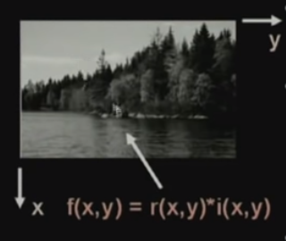
Image Representation in Digital Computer

Slide 5
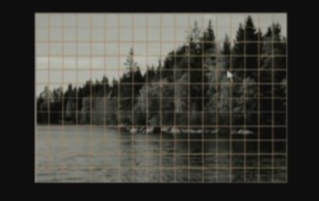
Sampling and Quantization
Spatial discretization by Grids
Intensity discretization by Quantization

Slide 6
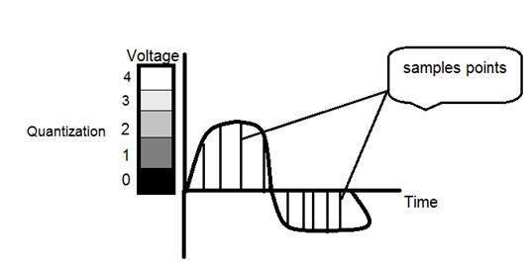
Sampling and Quantization
Spatial discretization by Grids ( Sampling)
Instead of storing all the intensity values of all possible points in the image we try to take samples of the image on a regular grid.
The grid is superimposed on this particular image and what we do is we take samples, image samples at various grid points.
Typically for image processing applications, the image size which is used is either 256 x 256 elements, 512 x 512 elements, 1 K x 1 K elements and so on.
Intensity discretization by Quantization
After sampling, at every point the value of that particular sample is again continuous. So it can assume any of the infinite possible values, which again cannot be represented in a digital computer.
Quantization is done using 8 bits for black and white image and using 24 bits for color image ( RGB planes).

Slide 7
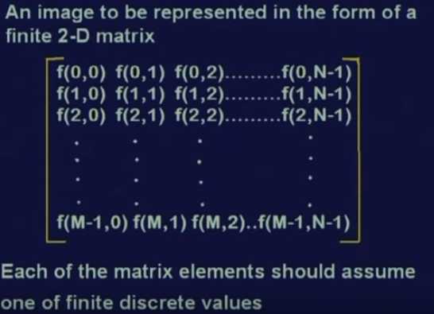
Desired Output after sampling and quantization
Image should be represented in a form of finite two dimensional matrix like this. So this is a matrix representation of an image and this matrix has got finite number of elements.

Slide 8
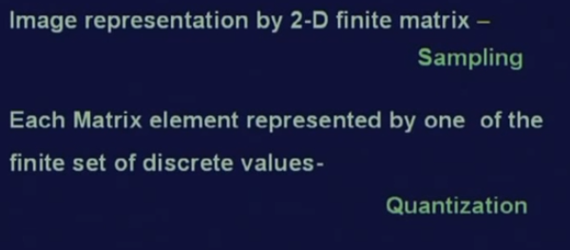
Image Digitization
Image Digitization= Sampling + Quantization

Slide 9
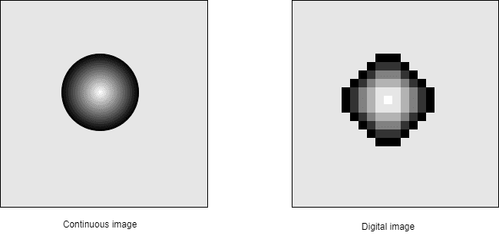
Image Digitization

Slide 10
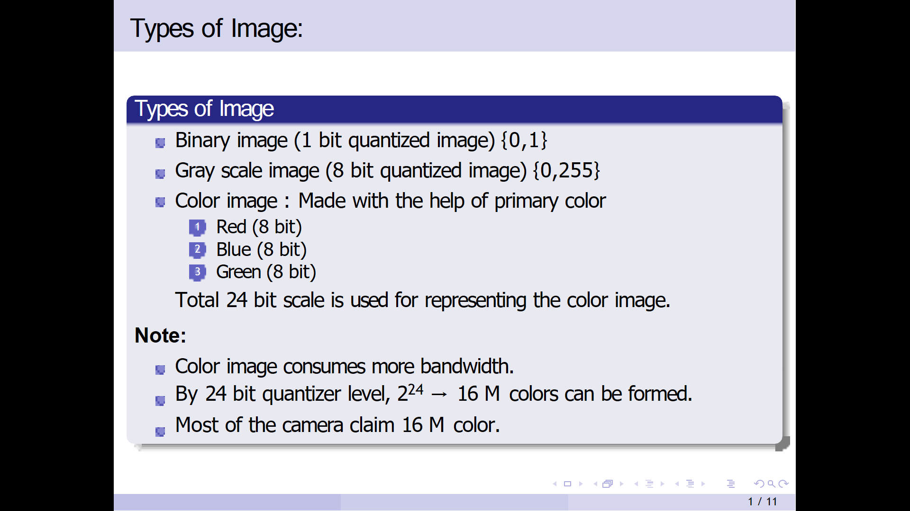
Types of Images

Slide 11
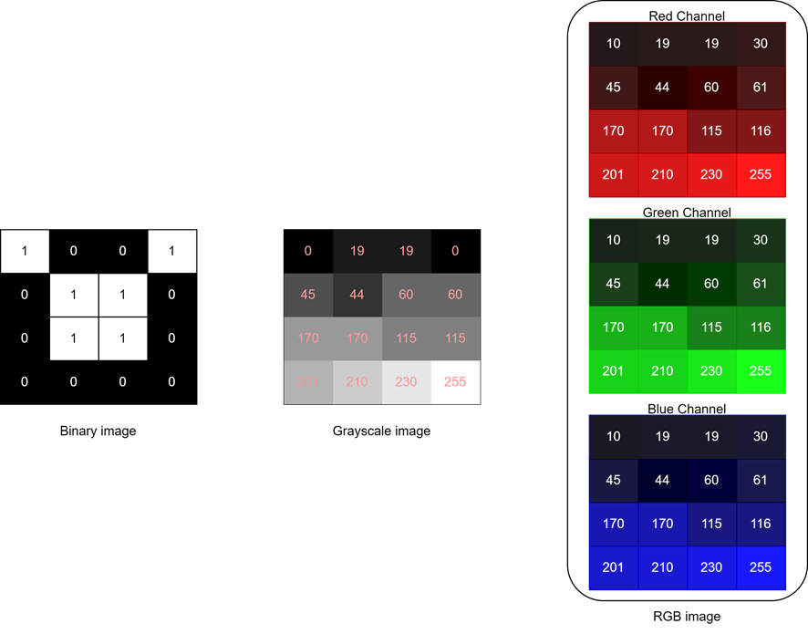
Image Digitization

Slide 12
Advantage of Digitization
Storage and retrieval of digital images are faster as well as cheaper than analog images.
Digital images allow compression (size reduction) using a variety of methods.
We can segment a digital image by detecting discontinuities such as points, lines, and edges.

Slide 13
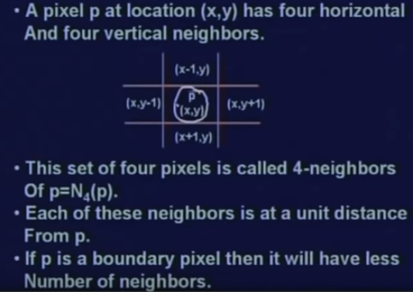
Relationship between Pixels
Neighbourhood of Pixels
4 Neighbourhood

Slide 14
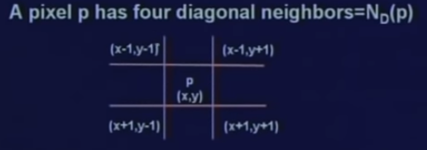
Relationship between Pixels
Neighbourhood of Pixels
Diagonal Neighbourhood

Slide 15
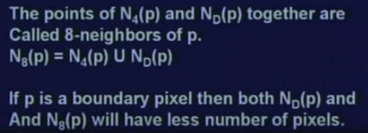
Relationship between Pixels
Neighbourhood of Pixels
8 Neighbourhood

Slide 16
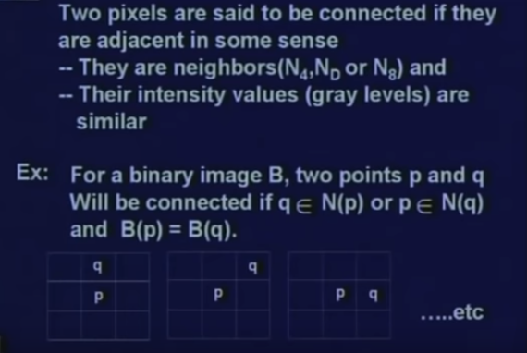
Connectivity
It is used for establishing boundaries of objects and components of regions in an image.

Slide 17
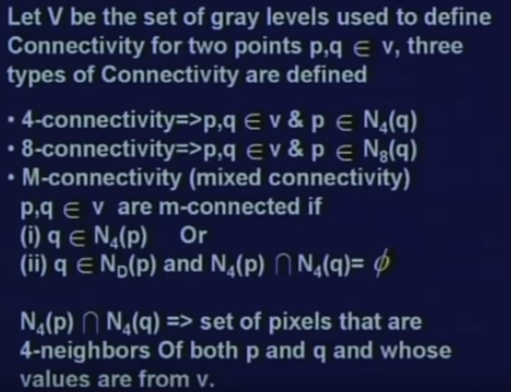
Connectivity

Slide 18
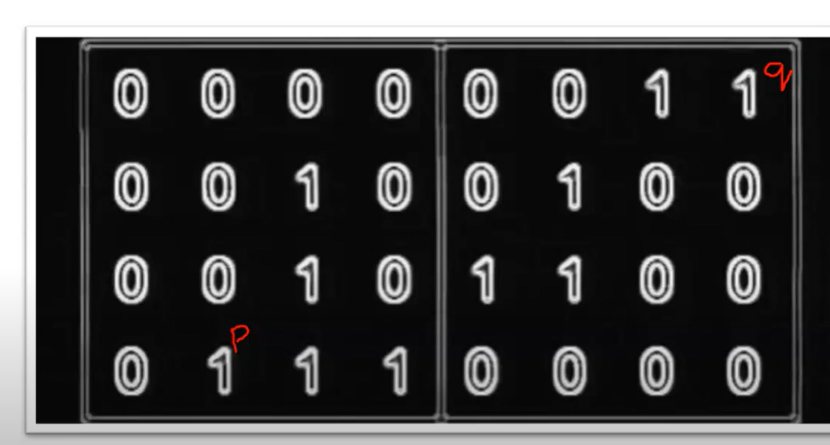
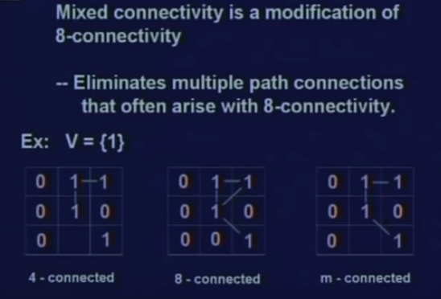
Connectivity

Slide 19
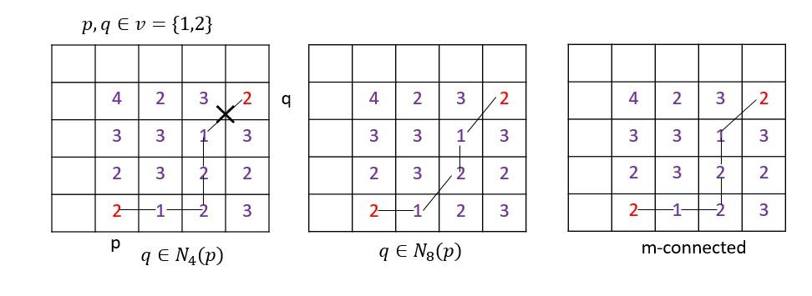
Connectivity

Slide 20
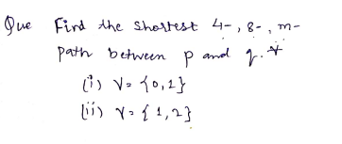
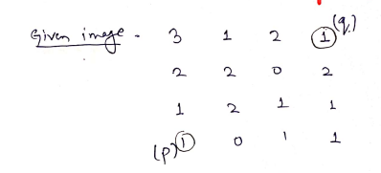
Example for solving

Slide 21
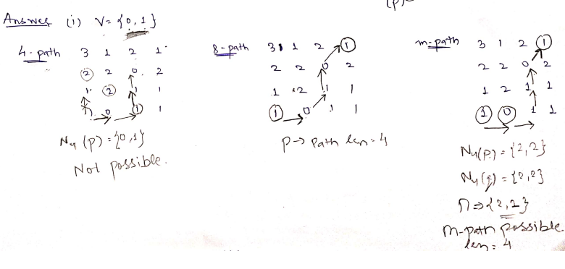
Example for solving

Slide 22
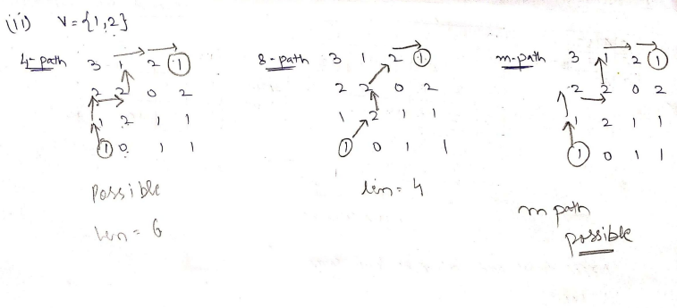
Example for solving

Slide 23
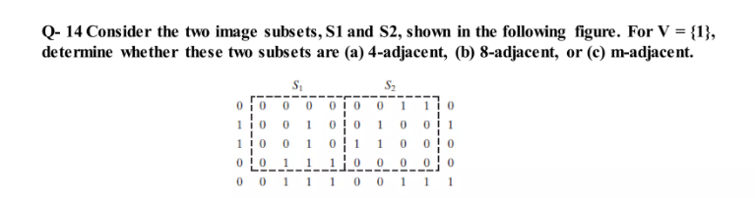
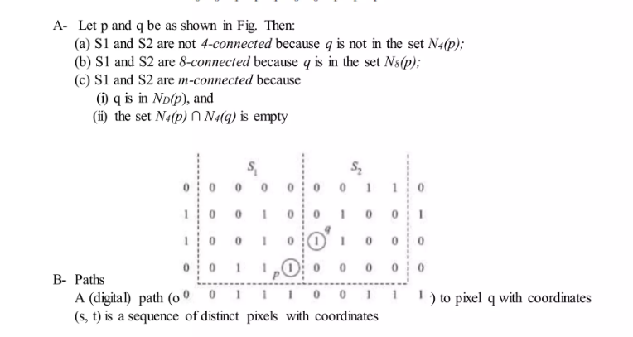
Example for solving

Slide 24
Image File Formats
BMP ( Bit Mapped Graphic Image)
Developed by Microsoft
Can save both monochrome and colour image
Very Good quality images
Occupy lot of memory
Eg- wall paper images, Image editing
TIFF ( Tagged Image File Format)
Developed by ADOBE
Large file size. Hence, Occupy lot of space.
Very high Quality Images
Because of large sizes, plugins are generally required to display them on internet sites
May or may not be compressed (Uses Huffman coding and LZW algorithm for compression)
Eg- OCR, HD imaging
JPEG ( Joint Photographic Expert Group)
Compressed Images
Occupy very little space
Uses DCT for compression
Lossy compression algorithm
Quality is not good

Slide 25
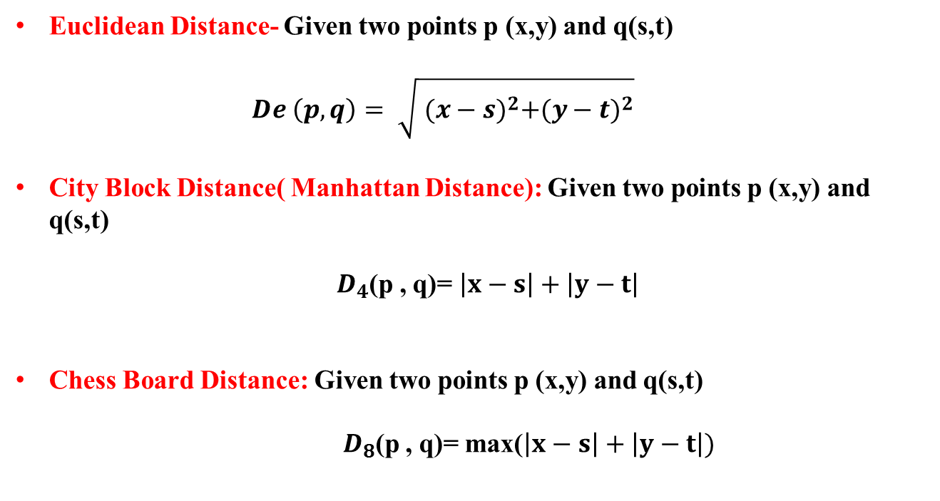
Distance Measures
Euclidean Distance- Given two points p (x,y) and q(s,t)
$$De \left(p,q\right)= \sqrt{ {(x−s)}^{2}+{(y−t)}^{2}}$$
City Block Distance( Manhattan Distance): Given two points p (x,y) and q(s,t)
$D_{4}$(p , q)= $\left|x−s\right|+\left|y−t\right|$
Chess Board Distance: Given two points p (x,y) and q(s,t)
$D_{8}$(p , q)= max($\left|x−s\right|+\left|y−t\right|)$

